Slide 1
Research Group Presentation By: Muhammad Imran

Slide 2
Research Topic
Develop and test a GIS technique and tool for depth mapping and translation to consequences using remote sensing data
Flood inundation map
Flood water depth estimation
Linking depth with damages using depth damage functions

Slide 3
goal of your research
Methodology (Method)
important results that fit your story/goal
Conclusion

Slide 4
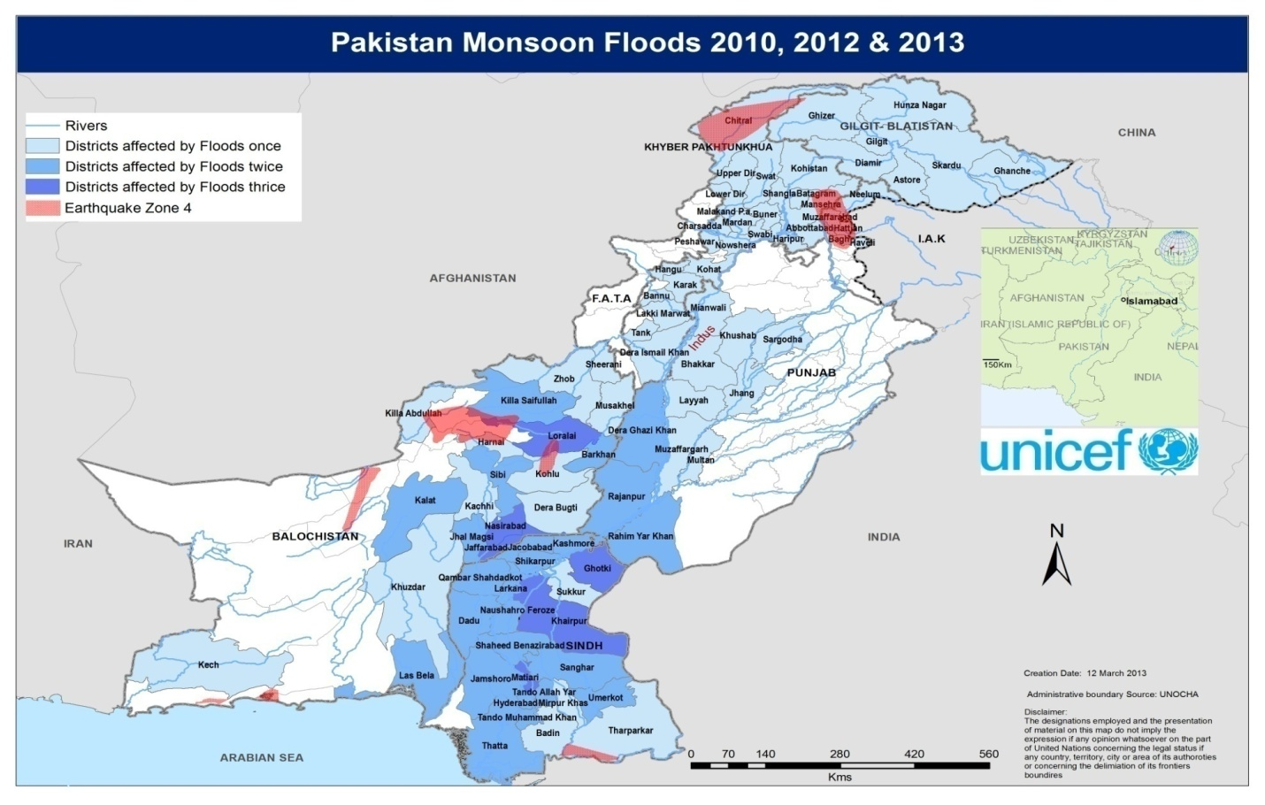
Floods in Pakistan
Riverine and flash floods
Riverine floods due to snow/glacier melting and monsoon (June-Aug) rainfall
Main affected areas lies on the banks of Indus and Chenab
Flood Statistics in Pakistan
2010
2011
2012
Most Impacted Areas
Southern Punjab
Northern Sindh

Slide 5
Floods in Pakistan
Insert visualization, statistics, plots

Slide 6
Big Picture
Flood Modeling
Remote Sensing (Inundation Map)
Depth extraction
Consequences
SDG
WEF
Hazards

Slide 7
Previous Studies
Pakistan Flood Impact Assessment, 2010, World Food Program
Market situation
Livelihood and Assets
Food Security
Kirsch, Thomas D., et al. "Impact of the 2010 Pakistan floods on rural and urban populations at six months." PLoS currents 4 (2012).
Focused primarily on WASH aspect pre and post flood conditions
Preliminary Damage Estimates for Pakistan Flood Events, 2010, Ball State University
National Disaster Management Reports (2010, 2011)
District wise data aggregated

Slide 8
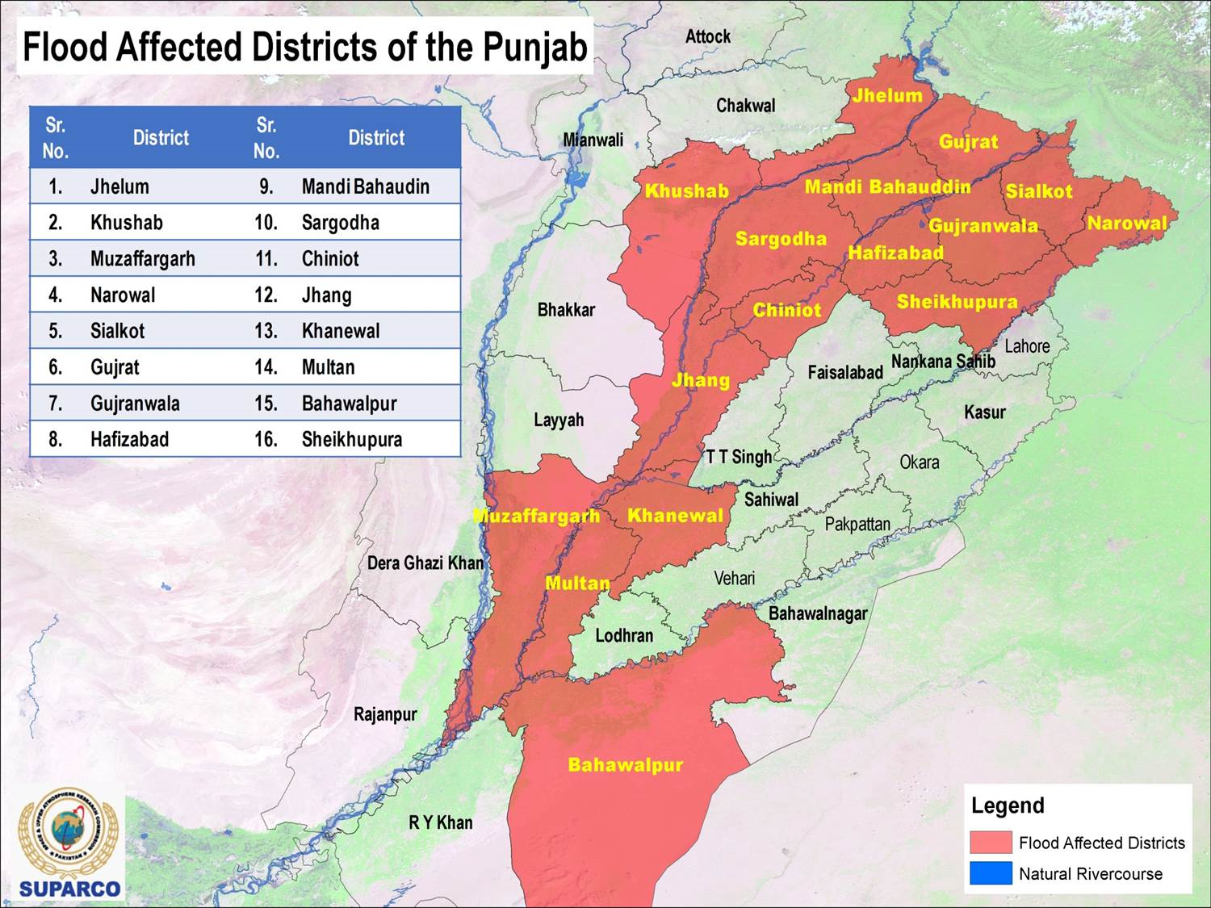
Case Study
Rajanpur – Punjab District
Flood years
2010
2011
2013
2014

Slide 9
Data Required
Digital Elevation Model
30m resolution data (USGS-LPDACC)
SAR – Optical Imagery
Pre and post event
Land Use
Damage (NDMA)

Slide 10
Next Steps
Data Collection
Land Use
DEM (High Resolution)
Rain intensity (Rainfall hyetograph) for the event
Soil maps to find infiltration Rate
Landuse maps to find runoff coefficients
Friction coefficients map
Flood Inundation Mapping
Water Depth Estimation

